Slide 1
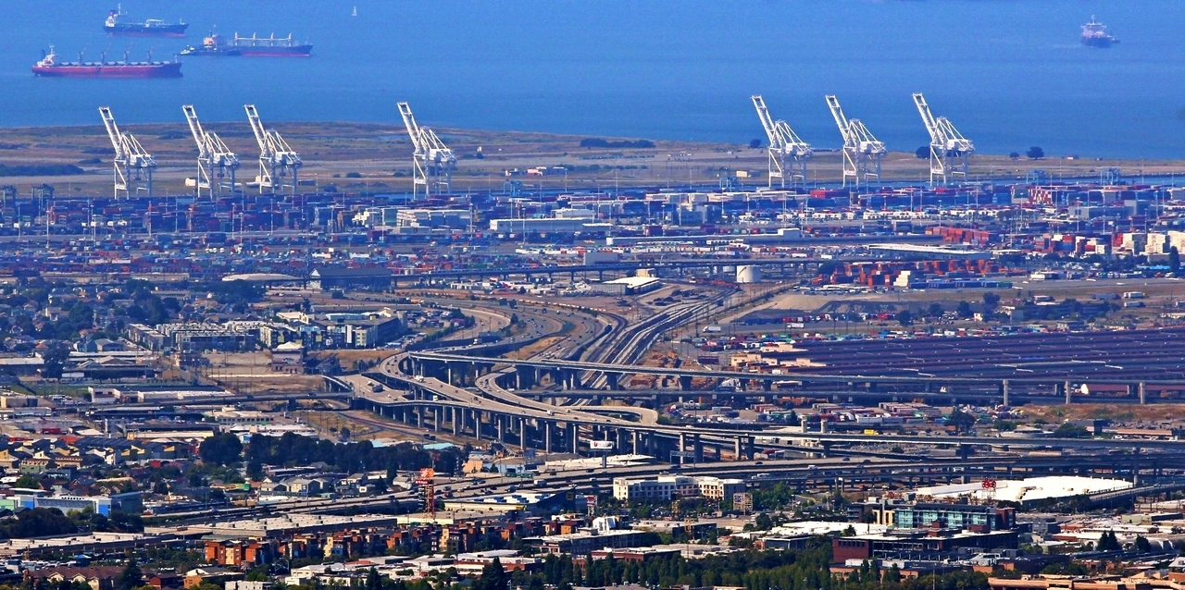
Data Science for Transportation
Dr. Greg Erhardt
261 OHR 859-699-1761 greg.erhardt@uky.edu

Slide 2
Setup
1. Connect to your virtual machine (VM)
http://protocols.netlab.uky.edu/~pike/vmPrimerWin10.html
2. Do some basic clean up:
- Create a C:\CE599 folder at the root
- Unpin the windows store and Edge
- Make chrome your default browser

Slide 3
Software Installs
Notepad++
https://notepad-plus-plus.org/
Github Desktop
https://desktop.github.com/
Anaconda python distribution for python 3.5
https://www.continuum.io/
MarkdownPad 2
https://www.markdownpad.com/
QGIS (worry about this later)
http://www.qgis.org/en/site/

Slide 4

Why Data Science?

Slide 5
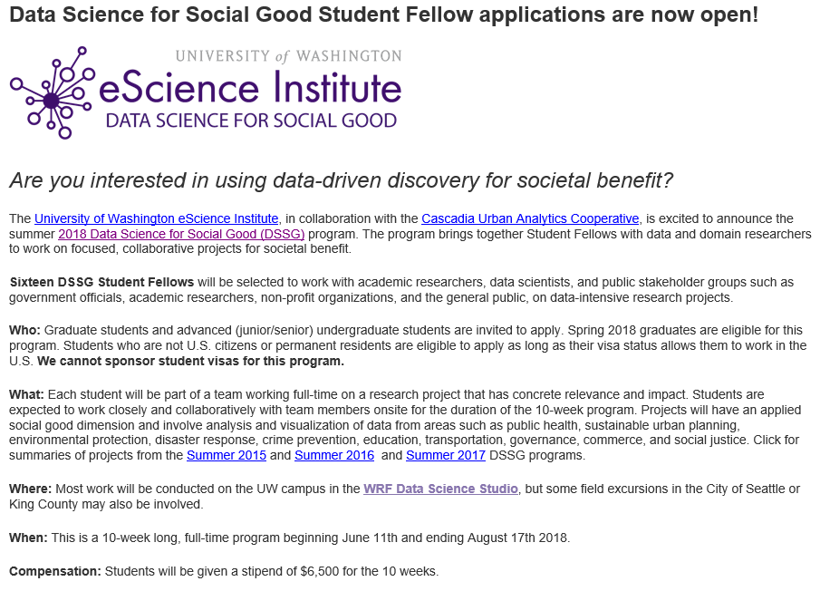
Why Data Science?
http://escience.washington.edu/dssg/

Slide 6
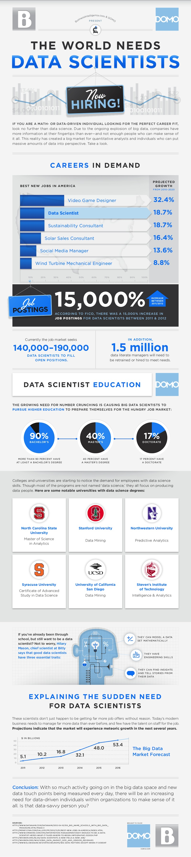
Why Data Science?
http://venturebeat.com/2013/11/11/data-scientists-needed/

Slide 7
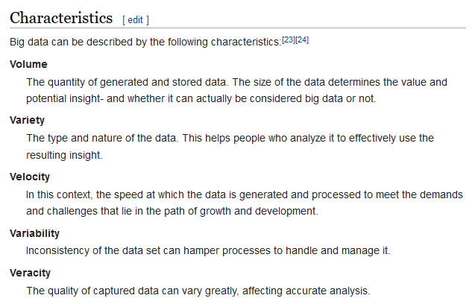
What is Big Data?

Slide 8
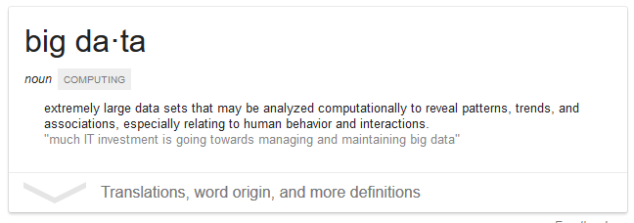
What is Big Data?

Slide 9
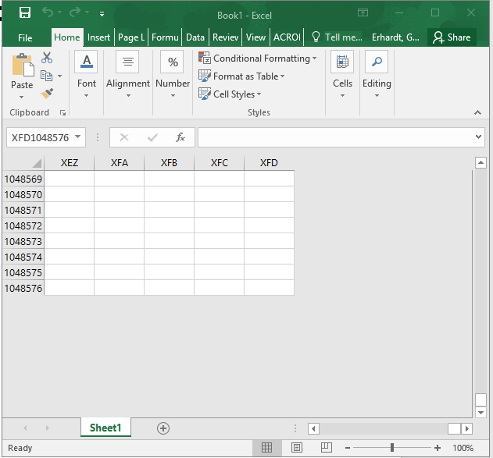
What is Big Data?
Anything that doesn’t fit in an Excel spreadsheet

Slide 10
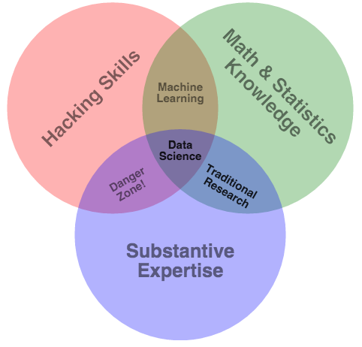
What is Data Science?
http://drewconway.com/zia/2013/3/26/the-data-science-venn-diagram.

Slide 12
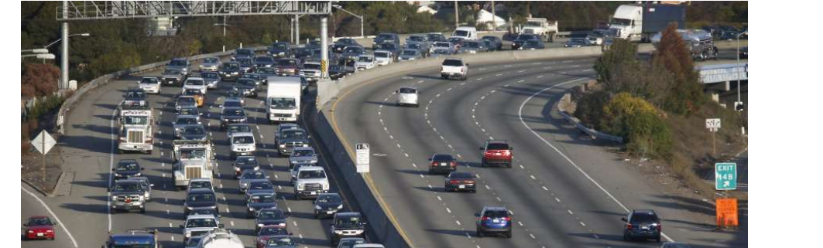
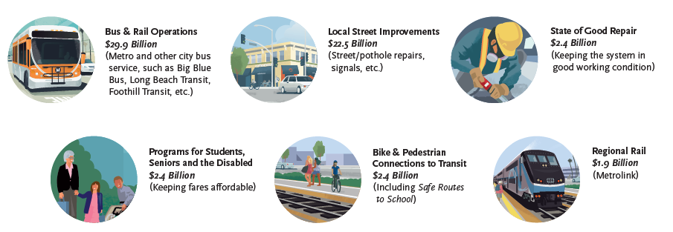
Why Transportation?

Slide 13
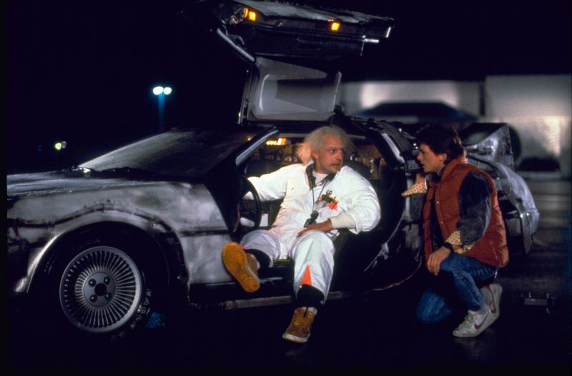
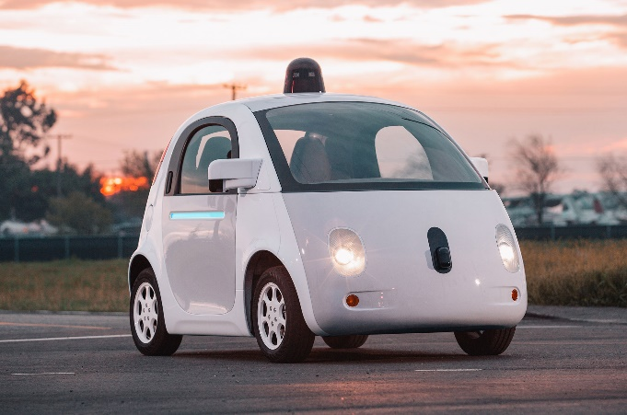
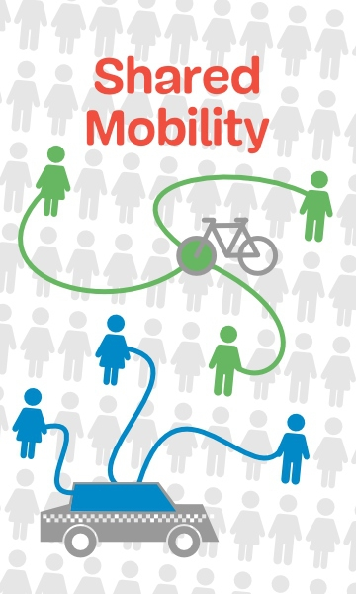

Why now?

Slide 14
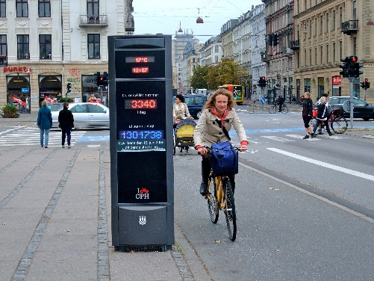
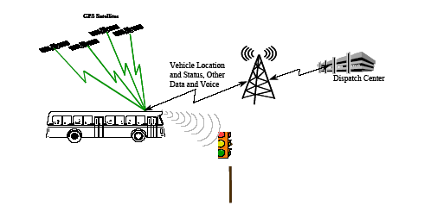
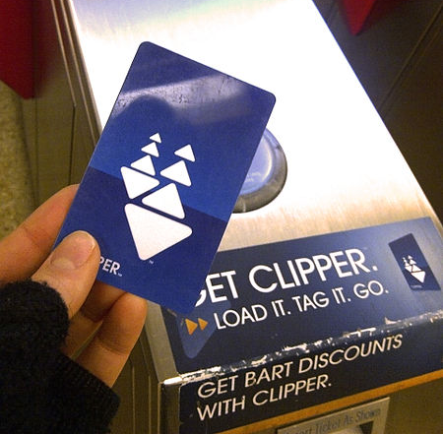
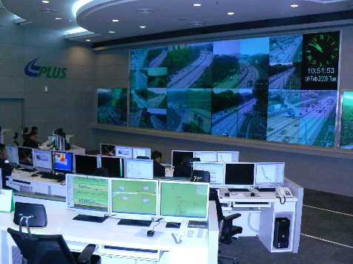

Increasingly, relevant and detailed data are being continuously collected, providing an opportunity to measure the changes that occur in the transport system.
Image from: wikipedia.com
Image from: appliedcomm.com
Image from: commons.wikimedia.org
Image from: commons.wikimedia.org
Image from: sfpark.org

Slide 15
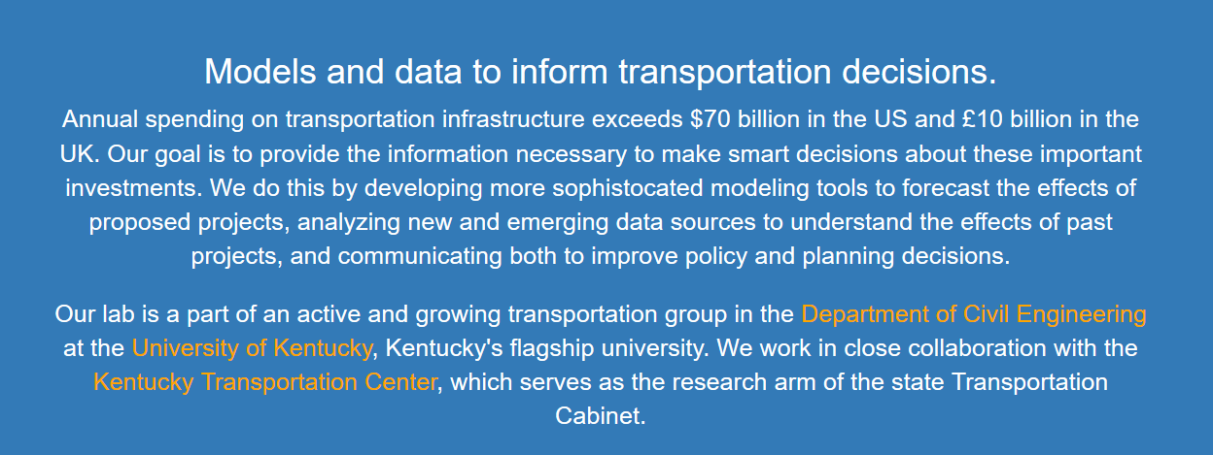

What I do…
What about you?

Slide 16

A note…
I’ve just given you a bunch of hype…
…can you separate the hype from the reality?

Slide 17
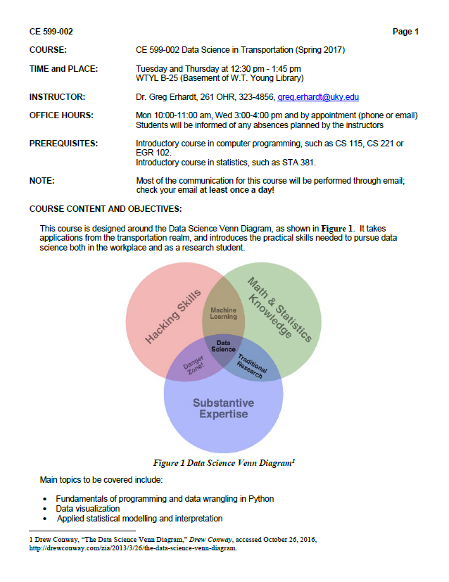
Syllabus & Expectations

Slide 18
Sources of Help
This is a “figure it out” class, not a “sit and listen” class!
Use these resources:
Class time
Text books, Libraries, Librarians
Dr. Google
Peers
Me
We won’t cover everything, but I hope you will start to learn how to “figure it out”

Slide 19
Let’s get started
Go to:
https://github.com/uky-transport-data-science/ce599
Download a zip file, and unzip it on your computer.
Poke around and see what’s in there.

Slide 20
Let’s get started
Open a command prompt
Shift + Right Click, or cmd from windows
5. From the class directory, type:
jupyter notebook
Open:
Introduction-to-jupyter-notebooks-and-python.ipynb

